Slide 1
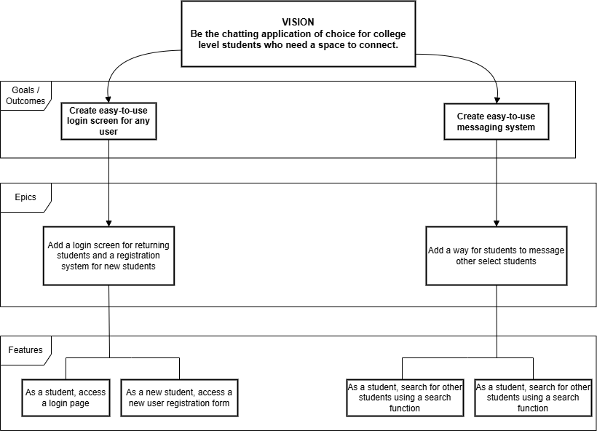
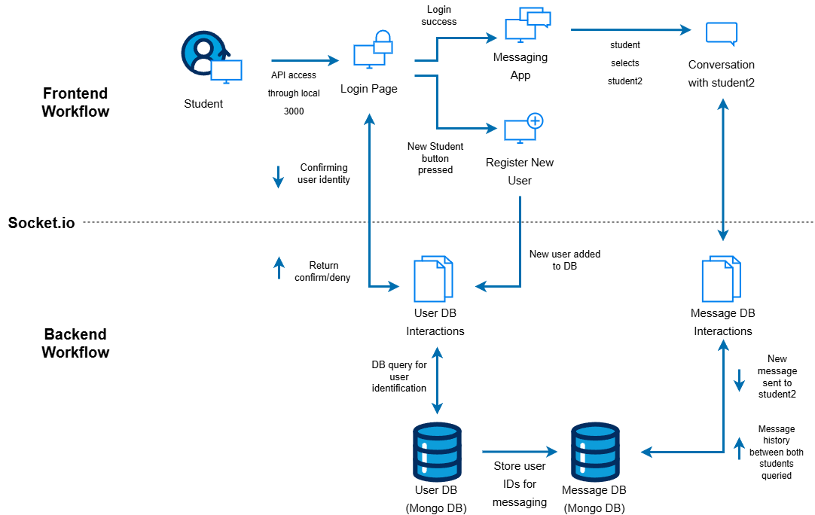
Artifacts
Small Informational on some of the Overall Details

Slide 2
Feature Breakdown Structure (FBS)
Vision
Goals/Outcomes
Epics
Features
What’s the big idea here?
The ideal/perfect scenario
Goal/Outcome of what?
Large specified pieces
Ingredients to bake the cake

Slide 3
Context Diagram
Important Sections
Register New User
User DB Interactions
User DB
Message DB
Message DB Interactions

Slide 4
(CD) Register New User
License and Registration please
Username
Password
“Profile Picture”

Slide 5
(CD) User DB Interactions
The User DB Doorman
Verification
Registration
ID-Message interaction

Slide 6
(CD) User DB (Mongo DB)
The King of Memory games
Users
ID
User-ID relationship

Slide 7
(CD) Message Database (Relational)
The Queen of that thing the King is King of
Messages
Relational?
Relational

Slide 8
(CD) Message DB Interactions
The Message DB Scribe (I’d say Doorman again but where’s the fun in that?)
Verification
Registration

